Slide 1

Personal Property
Efile Instructions
If at any time we can be of assistance, please don’t hesitate to contact our office.
360.249.4121 / assessor@graysharbor.us

Slide 2
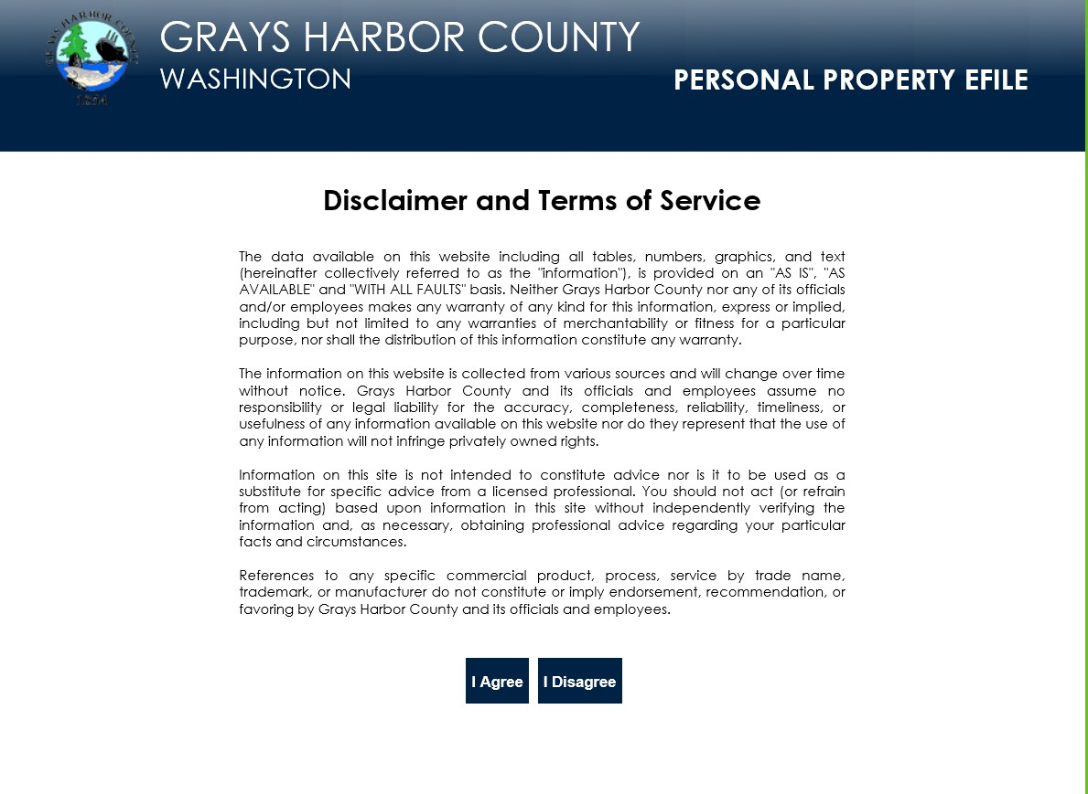
Filers will be required to accept the standard disclaimer.

Slide 3
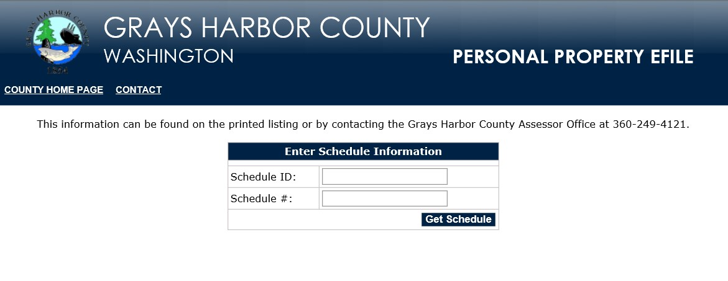
Logging into Personal Property Efile

Slide 4
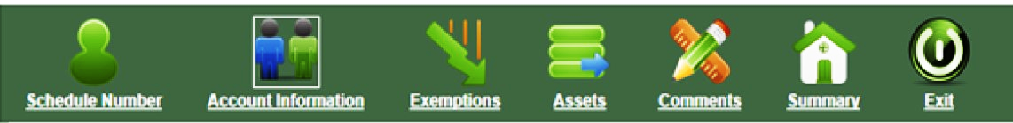
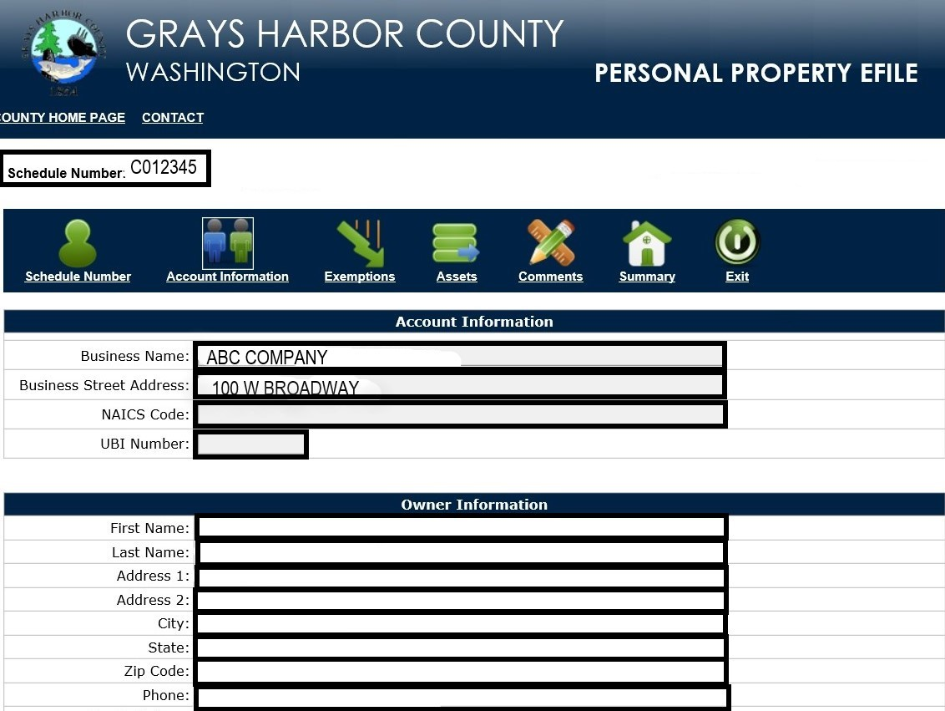
The schedule information is returned to the form for the user to begin reviewing and editing the data.
Navigation:
Users can toggle back & forth from screen to screen by selecting the previous / next buttons at the bottom of the page or by selecting an Icon at the top of the form.
Filers can only edit information in the Account Information Section.
Changes to owner information need to be completed by the Assessor’s Office. Please call 360.249.4121 for assistance.

Slide 5
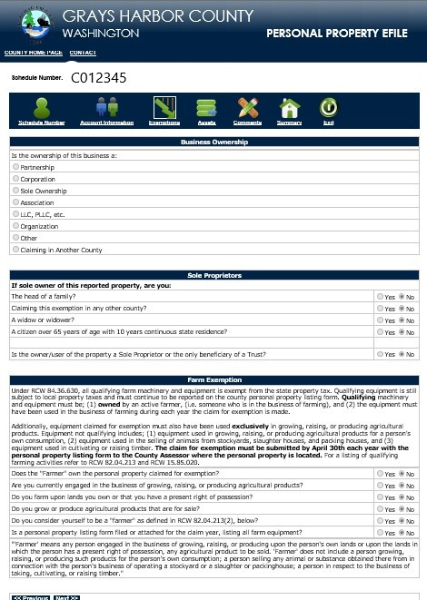
EXEMPTIONS
Those who qualify for a Personal Property Exemption can designate their status in the Exemption section.
The assessor staff will review the exemption once the return is submitted.
The exemption form contains the same questions available on the State of Washington’s Farm & Machinery Exemption applications

Slide 6
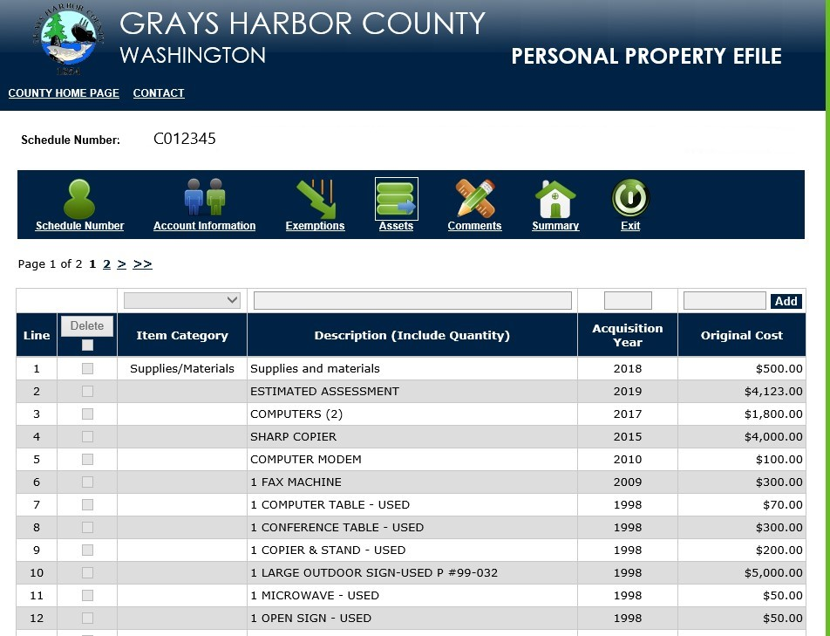
ASSETS
The Assets section contains the list of line items from the Personal Property Schedule.
The top of the page contains a pop up where you will enter supplies & materials not held for sale.
If inventory as of January 1st is representative of a monthly average, enter that amount.
If only the annual figure is known, divide by 12 and enter that result.
When entering data, please include the quantity, the description and the original cost of each item.
Users can add, edit or delete existing line items from the assets page.

Slide 7
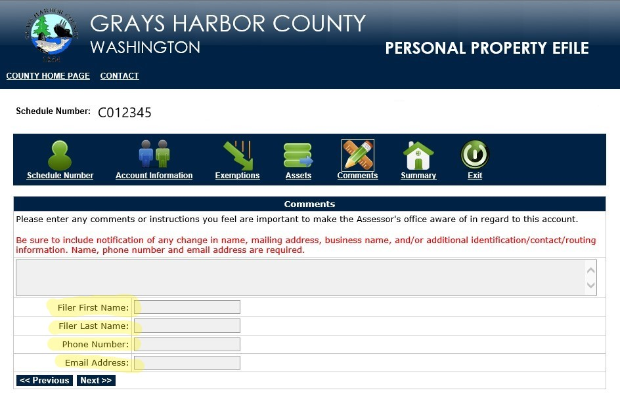
COMMENTS
In this section the Filer can enter comments for the Assessor’s Office related to the filing.
The Filer information in this section is required for the user to continue to the next page.
If information is missing an error message will display listing the corrections to be made.

Slide 8
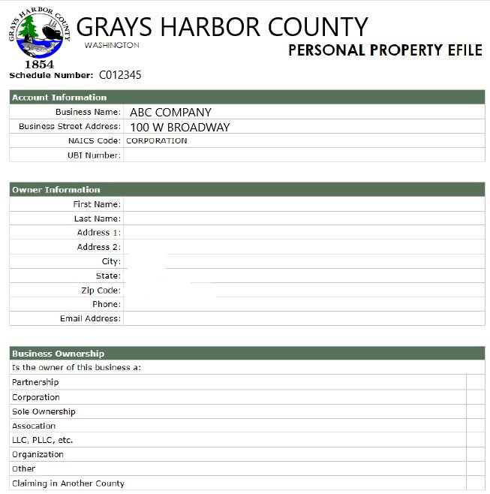
SUMMARY OF PERSONAL PROPERTY EFILE
The Summary provides the user an opportunity to review the return prior to printing and submitting to the Assessor’s Office

Slide 9
SUBMITTING THE RETURN
A pop-up message will display verifying you are ready to submit.
Once the return is submitted it is locked from editing on the eFile website and the following message will display.
The information in the Assets Section then becomes grayed out.

